Slide 1
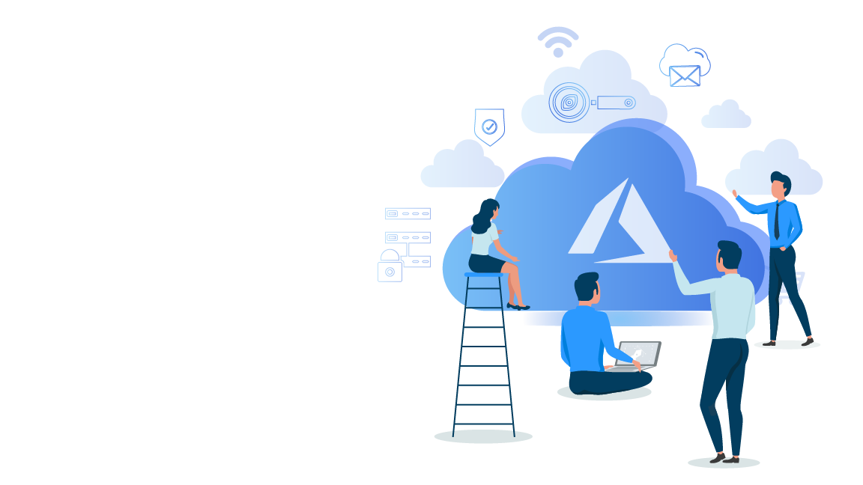


Microsoft Azure Administrator Associate Training (AZ-103)
Module 3

Slide 2
Agenda
01
02
03
04
05
06
07
What is Azure Virtual Machine?
Configurations of Azure VM
Azure VMs and Network Interfaces
What is a Virtual Machine?
Hands-on
Data Disks in Azure
Hands-on

Slide 3
Agenda
08
09
10
11
12
13
14
Why Use Virtual Machine Scale Sets?
Automating Deployment in Azure
VHD Templates
What are Azure VM Scale Sets?
Hands-on
ARM Templates
Hands-on

Slide 4
Agenda
15
16
17
18
19
20
21
Hands-on
Backing Up Policies
Hands-on
Custom VM Images
Backing Up an Azure VM
Restoring an Azure VM
Azure Site Recovery

Slide 5
What is a Virtual Machine?

Slide 6
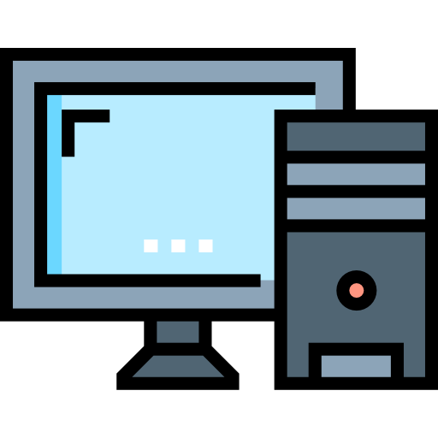

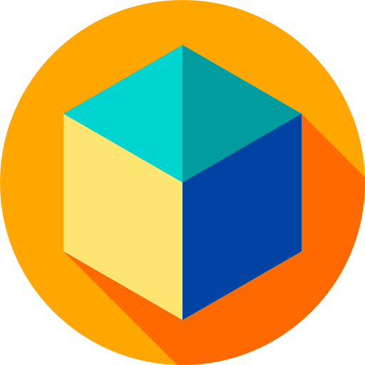
What is a Virtual Machine?
A virtual machine is a virtual emulation of a physical computer system. It is a virtual environment that includes components such as CPUs, memory, network interfaces, and more, giving end users the same experience on a virtual machine as they would have on a normal physical computer machine
Physical Computer System
Virtual Machine

Slide 7
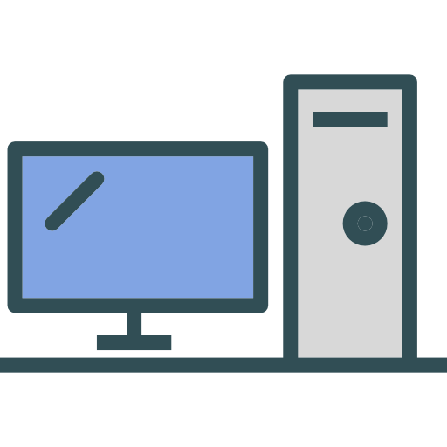
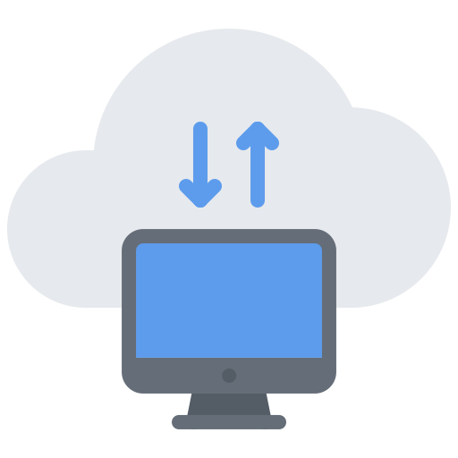
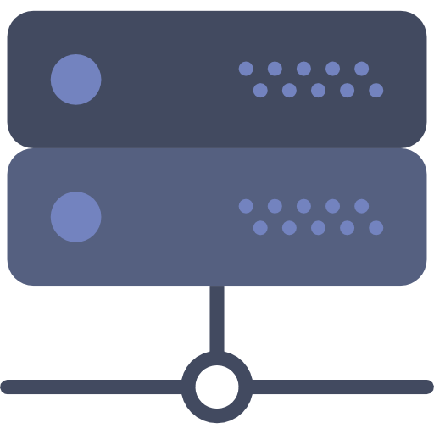
What is a Virtual Machine?
Virtual machines can be created on another physical computer system, called the host machine. Virtual machines can also be created on servers or in the cloud

Slide 8
Why would you use a Virtual Machine?
VM 2
Virtual Machines can be used to:
VM 1
VM 3
Create multiple virtual machines and run all of them on a single physical computer
Create single-purpose servers without actually having to set up a whole physical computer
Create high-availability clusters and minimize downtime
One Physical Machine

Slide 9



Why would you use a Virtual Machine?
Virtual Machines can be used to:
Create multiple virtual machines and run all of them on a single physical computer
Application Testing Server
Create single-purpose servers without actually having to set up a whole physical computer
Database Server
Authentication Server
Create high-availability clusters and minimize downtime

Slide 10
Why would you use a Virtual Machine?
Virtual Machines can be used to:
Create multiple virtual machines and run all of them on a single physical computer
Create single-purpose servers without actually having to set up a whole physical computer
Create high-availability clusters and minimize downtime

Slide 11
What is Azure Virtual Machine?

Slide 12
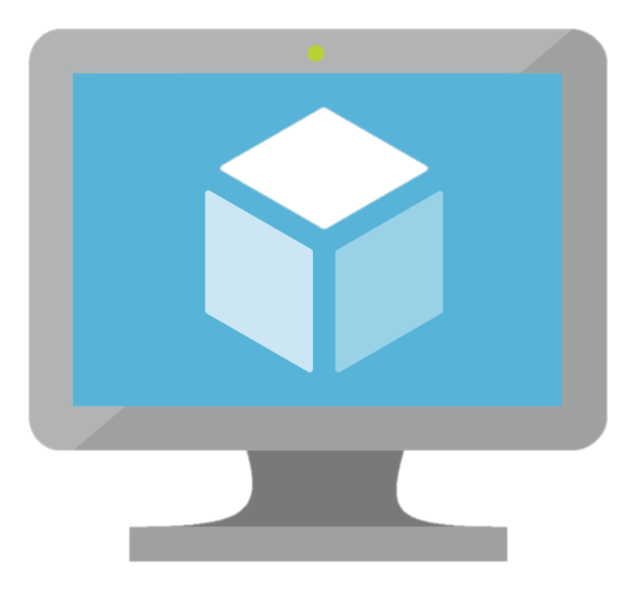
What is Azure Virtual Machine?
Azure VM is an IaaS offering from Azure. This service lets you launch virtual machines in Azure cloud, hence, giving you the flexibility of virtualization without having to buy and maintain the physical hardware

Slide 13
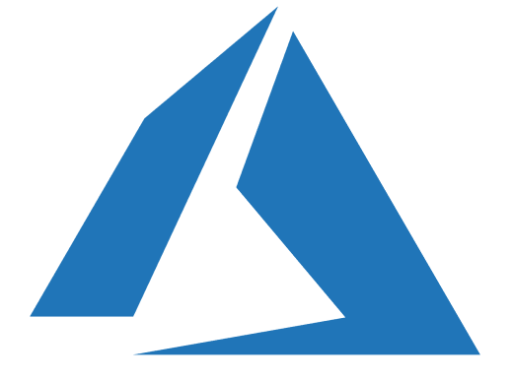
What is Azure Virtual Machine?
Azure offers different types of virtual machines, categorized on the basis of memory storage and compute types
For General Purpose
For High Processing Power
For High Compute workload
For Large Storage
And more

Slide 14
Types of Azure Virtual Machines

Slide 15
Types of Azure Virtual Machines
A Series VM
D Series VM
F Series VM
G Series VM
This type is used for entry-level workloads like development and test machines. It is economical and provides low-cost options
This type of VM is used to run applications with high compute power and temporary disk performance
F series VMs are optimized for intensive workloads and provide higher CPU to memory ratio
This is a storage- or memory-optimized VM. It offers 2 times more memory and 4 times more storage than the D series
H Series VM
L Series VM
M Series VM
N Series VM
H series virtual machines are the next-generation high-performance computing virtual machines
L series VMs are storage-optimized virtual machines. They are ideal for the applications that require low latency
M series VMs are the largest memory-optimized VMs. They are ideal for heavy in-memory workloads like SAP HANA
N series virtual machines are GPU-enabled (graphic processing unit-enabled) virtual machines

Slide 16
Types of Azure Virtual Machines
Types
Size | Description
Fsv2, Fs, F | Used in medium-traffic web servers, network appliance, batch process, and application servers. Below VM sizes are available in compute-optimized VMs
Esv3, Ev3, M, GS, G, DSv2, DS, Dv2, D | Used in relational database servers, medium-to-large caches, and in-memory analytics. Below VM sizes are available in memory-optimized VMs
Ls | This provides high-disk throughput and IO and is ideal for Big Data, SQL, and NoSQL databases. Ls series is only available in storage-optimized VM sizes, which offers up to 32 vCPUs
NV, NC, NCv2, ND | GPU-optimized VMs provide high-graphic performance, and these sizes are designed for compute-intensive, graphic-intensive, and visualization workloads
H, A8-11 | High-performance compute VMs use hardware designed and optimized for compute-intensive and network-intensive applications, including high-performance computing (HPC) cluster applications, modeling, and simulations
Compute-optimized
Memory-optimized
Storage-optimized
GPU - Optimized
High-performance Compute

Slide 17
Hands-on: Creating a Basic Azure VM Using Azure Portal

Slide 18
Overview of the Configurations of Azure VMs

Slide 19

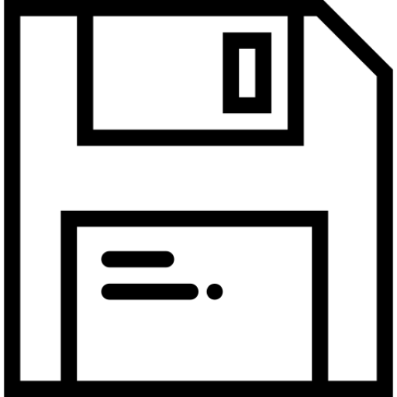
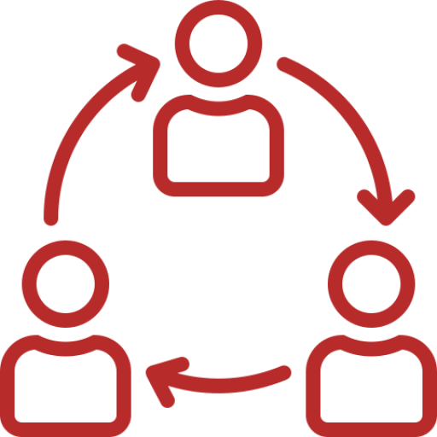


Overview of the Configurations
Basics
Minimal amount of information that is asked to create a virtual machine such as subscription, region, resource group, and so on
01
Disks
This tab gives you the oppurtunity to configure any data disk you might want with your virtual machine, along with letting you select the level of service those disk may serve
02
Networking
Networking-based configurations for your VM, e.g., if you want a public IP or not or if you want to open ports to enable different types of access to the VM
03
Management
This tab helps you manage and monitor your virtual machine. You can choose to have your VM automatically shut down, enable automated backup, and more
04
Guest Config
05
You can use this tab to congiure your VM to run some custom scripts. You can also use VM extensions
Tags
This tab allows you to set key–value pairs or labels to put on your virtual machines, making it easy to organise and filter your VMs later
06

Slide 20
Data Disks in Azure VMs

Slide 21
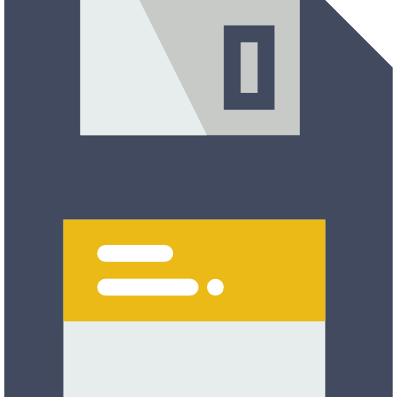
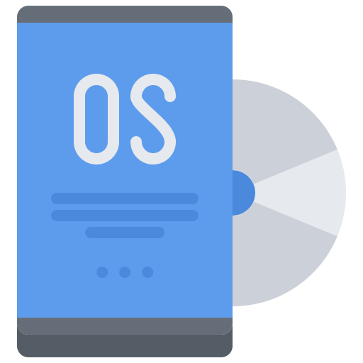

Disks in Azure Virtual Machines
Virtual machines in Azure use disks as a place to store an operating system, applications, and data. All Azure virtual machines have at least two disks
Operating System Disk
Temporary Disk

Slide 22
Disks in Azure Virtual Machines
Operating System Disk
Temporary Disk
The operating system disk is created from an image, and it is stored in an Azure storage account
There’s only one OS disk per VM
It is labeled as: C: drive for windows & /dev/sda for Linux by default
This disk has a maximum capacity of 2048 GB
The temporary storage provided with each VM has no extra cost associated with it for storage space and for transactions
Data on the temporary drive will be lost, when you resize, shutdown, or restart your VM, moved to a different host server
During a standard reboot of the VM, the data on the temporary drive should persist
01
02

Slide 23



What are Data Disks in Azure?
Data disks are analogous to a hard disk that is used with regular physical computers. Data disks behave like a virtual hard disk for your virtual computer deployed on Azure cloud
Virtual Hard Disks
Disks that you attach to Azure virtual machines are stored as Virtual Hard Disk (VHD) files within an Azure storage account
01
Number of Data Disks
02
The maximum number of disks is determined by the size of the VM
Data Disk Capacity
03
Each data disk has a maximum capacity of 4095 GB

Slide 24
Data Disks in Azure Virtual Machines
A few facts about disks in Azure Virtual Machines:
01
02
Azure disks are designed for 99.999% availability
A temporary disk is implemented as a local storage on the host where the VM is running
03
04
Operating system disks and data disks are implemented as blob storage in a storage account
Data disks provide persistent storage for applications and data

Slide 25
Managed and Unmanaged Disks
Difference Between Unmanaged and Managed Disks
You must create Azure storage accounts where these unmanaged Azure VM disks will reside
The maximum number of Azure storage accounts per region is limited to 200
When using a standard storage with unmanaged disks, you pay only for the space you use
Azure platform controls the placement of managed VM disk files
The limit on the number of storage accounts no longer applies. Although, there is a limit of 10,000 managed disks per region.
With managed disks, you pay for the full capacity of a disk, regardless of the disk space that is in use
Unmanaged Disks
Managed Disk

Slide 26
Azure VMs and Network Interfaces

Slide 27
VMs and Network Interfaces
A network interface enables an Azure virtual machine to communicate with the Internet, Azure cloud, and on-premise resources. When you create a virtual machine using Azure Portal, the portal creates one network interface with default settings for you
Alternatively, users can also choose to create network interfaces with custom settings
A VM must have at least one network interface but can have more than one, depending on the size of the VM you create
Each network interface attached to a VM must exist in the same location and subscription as the VM
A network interface can exist either in the same or in a different resource group than the virtual machine

Slide 28
Hands-on: Creating and Configuring an Azure Virtual Machine

Slide 29
What are Azure VM Scale Sets?

Slide 30
What are Azure VM Scale Sets?
Azure virtual machine scale sets let you create and manage a group of identical, load-balanced VMs. The number of VM instances can automatically increase or decrease in response with the demand or with a defined schedule

Slide 31
Why Use Virtual Scale Sets?

Slide 32




Why Use Virtual Scale Sets?
They are used to run multiple instances of your application. If one goes down, it can be accessed through other VM instances
Scale sets support up to 1,000 VM instances. If you create and upload your own custom VM images, then the limit will be 600
1
3
Create and Manage Multiple VMs
Automated Scaling
Work at Large Scale
High Availability
4
Scale sets let you easily manage hundreds of VMs without additional configuration tasks or network management
2
Scale sets can automatically increase and decrease the number of VM instances as application demand increases

Slide 33
Hands-on: Creating a Scale Set

Slide 34
What is an ARM Template?

Slide 35
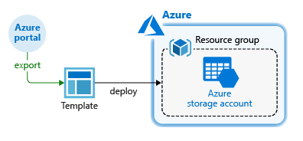
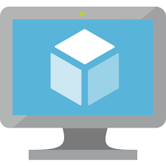
What is an ARM Template?
Azure Resource Manager template is a JSON file that defines a set of resources needed for an application. It also defines dependencies and parameters which enable a user to configure settings for resources while requesting the them
You can save a deployment as an ARM template and then use this template to automate that deployment, using Azure Portal

Slide 36
What is a VHD Template?

Slide 37
What is a VHD Template?
An Azure-managed disk is a virtual hard disk (VHD). You can think of it like a physical disk in an on-premises server, but virtualized
You can use VHD to deploy resources in Azure such as VMs in following ways:
01
You can create a new VM and attach an already existing VHD to it as an OS disk
02
You can create a new VM from the VHD of a VM that has been deleted
03
You can create an Azure VM from an on-premise VHD by uploading the on-premise VHD and attaching it to a new VM

Slide 38
Hands-on: Creating a VM from a Virtual Disk

Slide 39
What are Custom Images?

Slide 40
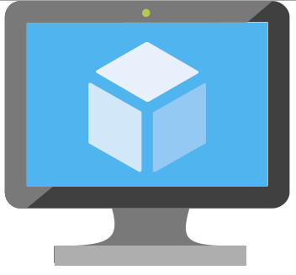

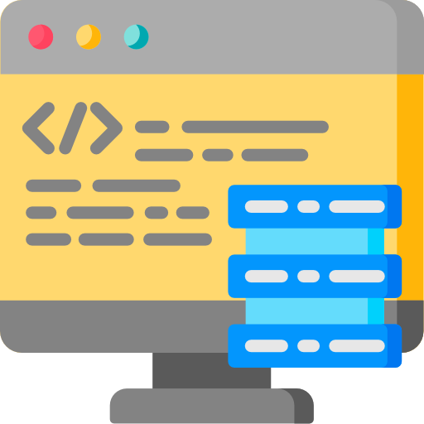
What are Custom Images?
An image is a copy of a VM or a template for creating a VM, which might contain an OS, data files, and applications. Using these custom images, you can create a VM
Operating System
Data Files
Applications

Slide 41
Hands-on: Deploying a VM from a Custom Image

Slide 42
Backing Up an Azure VM

Slide 43
What is Azure Backup Service?
Azure offers a built-in backup service that lets users backup their data to the Microsoft Azure Cloud. This service can also be used to take on-point backup of Azure VMs
VM backups in Azure are stored in Recovery Service vaults. You can access these Recovery Service vaults through Azure Portal
Azure gives full flexibility to configure and modify a VM backup
You can choose when to create a backup according to the time that works best for you
You can enable a backup for as long as you want
Recovery Service vaults are connected to your storage account and scale automatically to accommodate your backup
Azure backup is a pay-as-you-go service, i.e., you only pay for the storage amount that you use

Slide 44
Restoring a Backup
Create a New VM
Replace the Existing
Quickly creates and gets a basic VM up and running from a restore point. You can specify a name for the VM and a storage account for the restored VM
You can restore a disk and use it to replace the disk on the existing VM. The current VM must exist. If it's being deleted, this option can't be used
1
2
3
Restore the Disk
Restores a VM disk, which can then be used to create a new VM. Alternatively, you can attach the disk to an existing VM

Slide 45
Hands-on: Backing up and Restoring an Azure Virtual Machine

Slide 46
Azure Site Recovery

Slide 47
What is Azure Site Recovery?
Azure Site Recovery is a disaster recovery solution offered by Azure. This service makes sure that your data or workloads are available even during the outages
01
Site Recovery replicates workloads running on physical and virtual machines (VMs) from a primary site to a secondary location
When an outage occurs at your primary site, you failover to the secondary location and access apps from there. Once the primary location starts running again, you can failback to it
02

Slide 48

Quiz
1. Where are the operating disks and data disks stored?
A. As a blog storage in a storage account
B. Operating disks as a blob storage, while data disks as a local storage
C. Data disks as a blob storage, while operating disks as a local storage
D. None of the above

Slide 49
Quiz
2. What is an ARM template?
A. A JSON file defining resources and dependencies
B. An Azure tool to access the Azure platform
C. A PHP file defining resources and dependencies
D. None of the above

Slide 50
Quiz
3. You can deploy resources using an ARM template.
A. True
B. False

Slide 51
Quiz
4. Which of the following is correct?
A. An Azure-managed disk is a virtual hard disk (VHD) that can be used to deploy VMs
B. An Azure-managed disk is a virtual hard disk (VHD) that can only be used to store data
C. VHD template is another name for ARM template
D. None of the above

Slide 52
Quiz
5. Azure VM backup is the same as Azure VM restore.
A. True
B. False

Slide 53
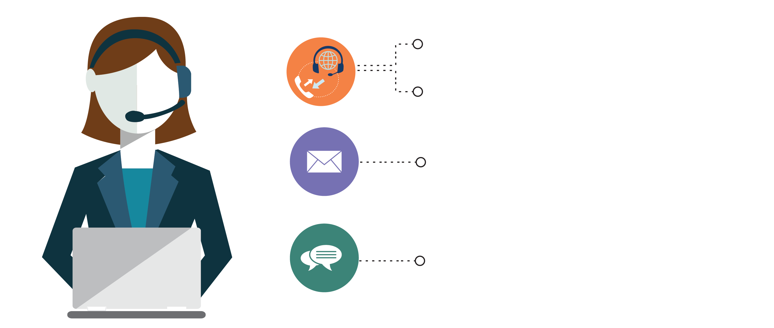
India: +91-7847955955
US: 1-800-216-8930 (TOLL FREE)
support@intellipaat.com
24/7 Chat with Our Course Advisor

